Slide 1
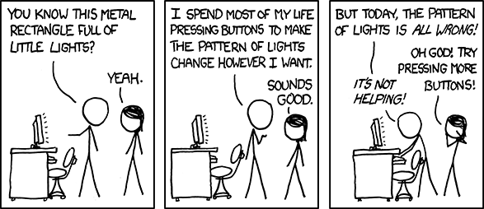
Lab 8: File I/O and Vectors

Slide 2
Agenda
Lecture Topic Review
Practice Questions
Lab 8 assignment
Weekly Reminders
Q&A

Slide 3
This week in lecture
Tuesday: Vectors, structs

Slide 4
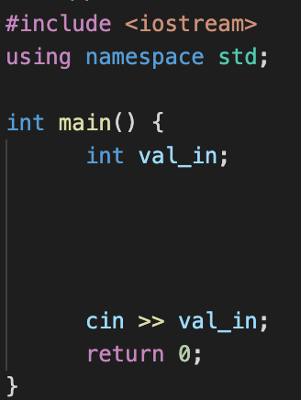
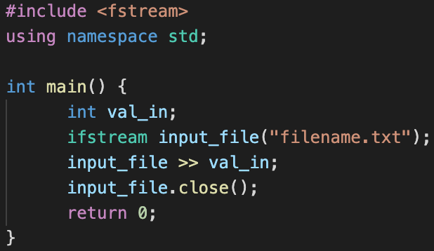
<iostream> vs. <fstream>

Slide 5
File I/O Syntax Review
Remember the library!
Variable name
Open a file called filename.txt
datatype
Reads in single integer from file
Closes file so it can’t be read again
Notes:
An object of type ifstream is of the type “input file stream”; read data from a file into variables

Slide 6
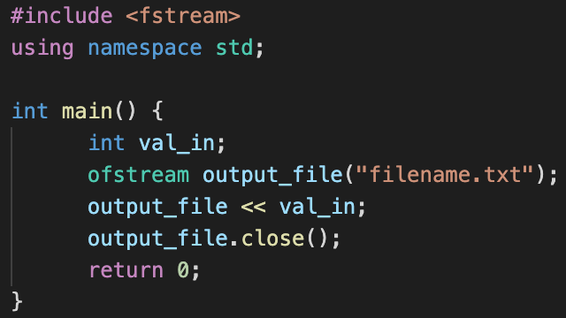
File I/O Syntax Review
Similarly, to write to file, use << operator! And type ofstream

Slide 7
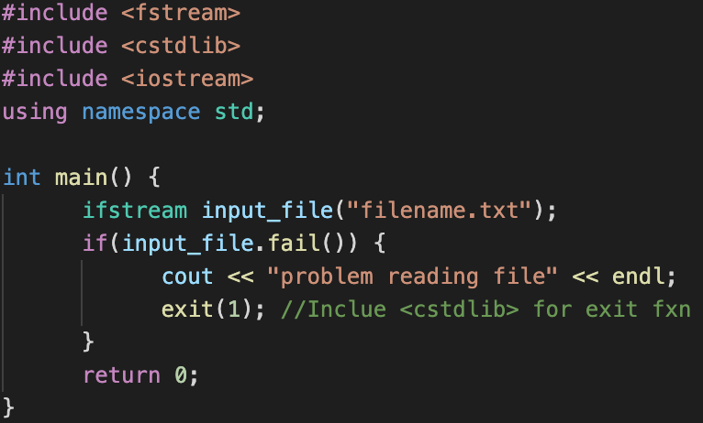
File I/O syntax review - check successful open

Slide 8
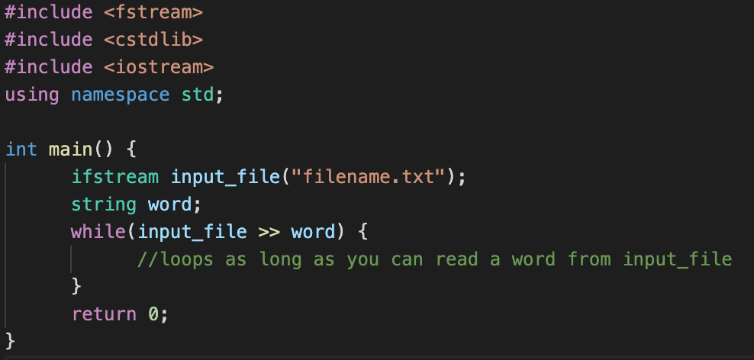
File I/O syntax review - reading by word

Slide 9
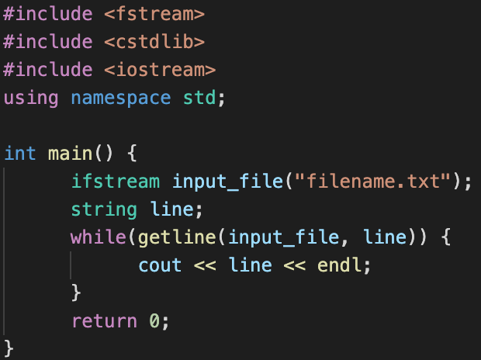
File I/O syntax review - reading by line

Slide 10
Vectors
Often we want to make lists of things that can dynamically change in size (unlike arrays!)
For these we use another class called the vector class
#include <vector>
• Can make vectors of any type, as long as the elements are the same type
vector <string> stringlist; //no specified size or values
vector <double> doublelist(10); //specified size
vector <int> intlist(5, -1); //specified size with
default initial value -1 for all 5 elements

Slide 11
Vectors - some common functions
v.back( ) refers to the last element
v.front( ) refers to the first element
v.empty( ) true if the vector is empty
v.clear( ) empties the vector
v.size( ) returns number of elements in the vector (as an unsigned int)
v.pop_back( ) removes the last element
v.push_back(e) appends another element
v.resize(newsize) changes size of the vector
v.resize(newsize,e) and puts e into any new elements

Slide 12
Vector of vectors
Vectors can be used to make lists of anything: int, double, char, string, ….
They can even store other vectors!
vector< vector <int> > table;
This is called a 2D vector
Don’t forget a space here!

Slide 13
Vector of vectors
A 2D vector can be visualized as a series of rows
If you think of vector <int> as a row of integers then you can think of
vector <vector <int> > as a series of rows
vector <vector <int> > table;
table[0] = 12 3 5 7
table[1] = 42 7 3 0
table[2] = 55 -1 2 6
table.at(0).at(1) == 3
table.at(2).at(2) == 2

Slide 14
Agenda
Lecture Topic Review
Practice Questions
Lab 8 assignment
Weekly Reminders
Q&A

Slide 15
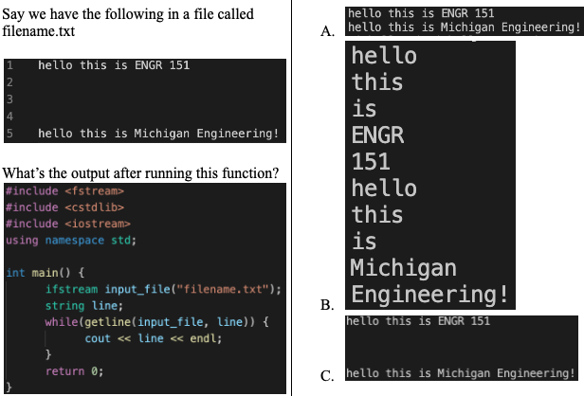
Practice Problem #1

Slide 16
Practice Problem #1

Slide 17
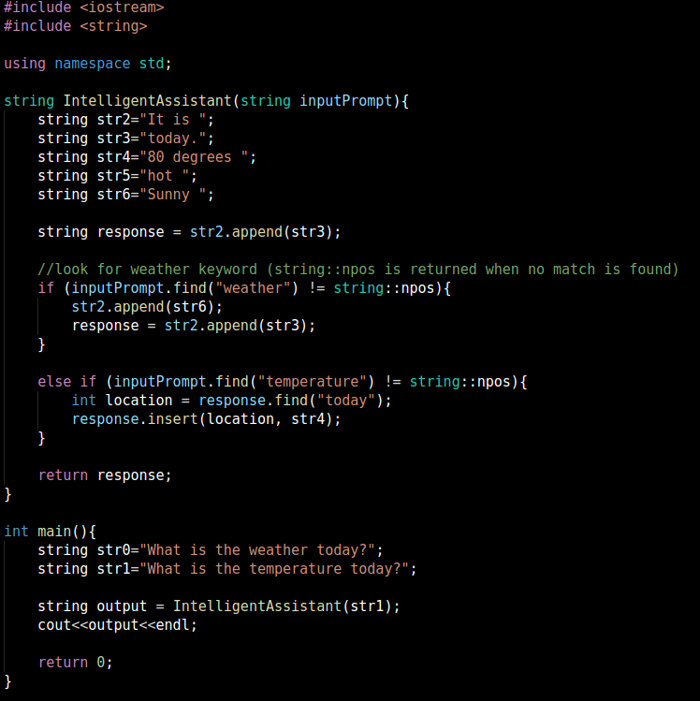
Practice Problem #2
Choose the right output
B)
C)

Slide 18
Practice Problem #2 Solution
Choose the right output
B)
C)

Slide 19

Practice Problem #3
Choose the right output
A)
B)
C)
A)
B)
C)

Slide 20
Practice Problem #3
Solution
Choose the right output
A)
B)
C)

Slide 21
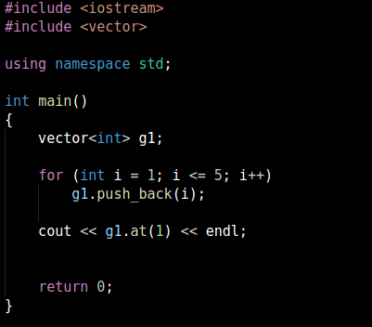
Practice Problem #4
Choose the right output:
1
2
0
None

Slide 22
Practice Problem #4 Solution
Choose the right output:
1
2
0
None

Slide 23
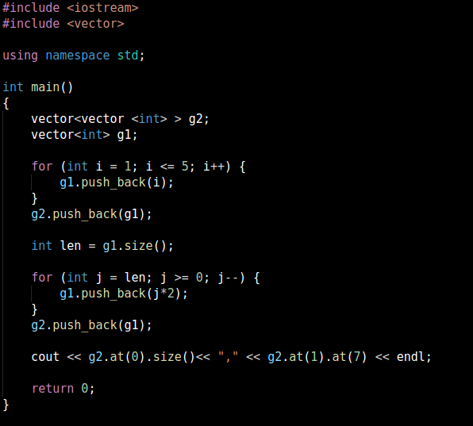
Practice Problem #5
Choose the right output:
11,8
5,8
5,6
11,6

Slide 24
Practice Problem #5
Choose the right output:
11,8
5,8
5,6
11,6

Slide 25
Agenda
Lecture Topic Review
Practice Questions
Lab 8 assignment
Weekly Reminders
Q&A

Slide 26
Today’s Lab
Two parts:
File I/O: data_entry.cpp you will create yourself
Vectors: parking.cpp (starter code on Canvas!)
Make sure to look at the provided .txt files too!
Libraries you may or may not need
<fstream>
<vector>
<string>

Slide 27
Today’s Lab: C++ Strings, File I/O, and Vectors
Appreciate using “==” for strings! (Can you compare arrays with “==”?)
You can read file input as loop condition
line by line: while(getline(stream,line))
word by word: while(stream >> word)
Don’t mix >> and getline!
Use functions in <string> library (reference table in lab assignment)

Slide 28
Agenda
Lecture Topic Review
Practice Questions
Lab 8 assignment
Weekly Reminders
Q&A

Slide 29
Weekly Reminders
Lab 8 due before Lab next week
Project 3 has been released and is due on 11/10
Lab 8 FAQ: https://docs.google.com/document/d/16SNcusD3GU1TOadg-xqg3lSwtGfjDt4XNZE0H5YXCPA/edit?usp=sharing

Slide 30
Questions?

